Slide 1

Security+ Guide to Network Security Fundamentals, Third Edition
Chapter 7
Access Control Fundamentals

Slide 2

Jérôme Kerviel
Rogue trader, lost €4.9 billion
Largest fraud in banking history at that time
Worked in the compliance department of a French bank
Defeated security at his bank by concealing transactions with other transactions
Arrested in Jan 2008, out and working at a computer consulting firm in April 2008
  Links Ch7a, 7b

Slide 3
Objectives
Define access control and list the four access control models
Describe logical access control methods
Explain the different types of physical access control

Slide 4
What Is Access Control?

Slide 5
Access Control
The process by which resources or services are granted or denied on a computer system or network
There are four standard access control models as well as specific practices used to enforce access control

Slide 6
Access Control Terminology
Identification
  A user accessing a computer system would present credentials or identification, such as a username
Authentication
  Checking the user’s credentials to be sure that they are authentic and not fabricated, usually using a password
Authorization
  Granting permission to take the action
A computer user is granted access
  To only certain services or applications in order to perform their duties
Custodian
  The person who reviews security settings
  Also called Administrator

Slide 7
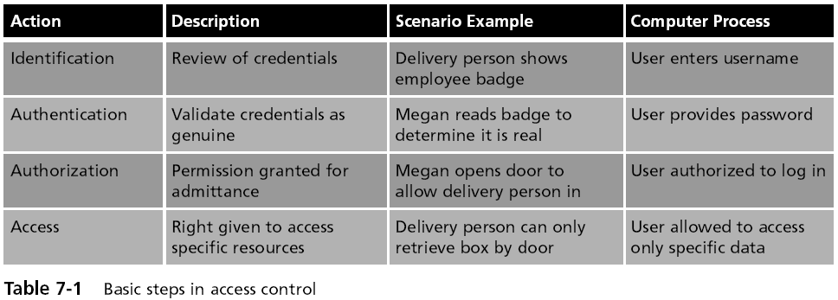
Access Control Terminology (continued)

Slide 8
Access Control Terminology (continued)
Computer access control can be accomplished by one of three entities: hardware, software, or a policy
Access control can take different forms depending on the resources that are being protected
Other terminology is used to describe how computer systems impose access control:
  Object – resource to be protected
  Subject – user trying to access the object
  Operation – action being attempted

Slide 9
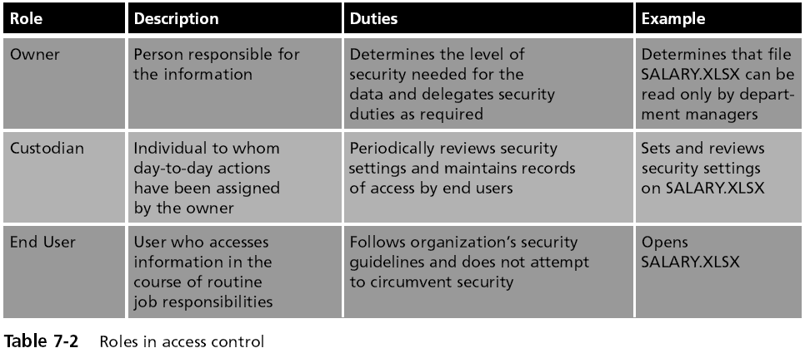
Access Control Terminology (continued)

Slide 10
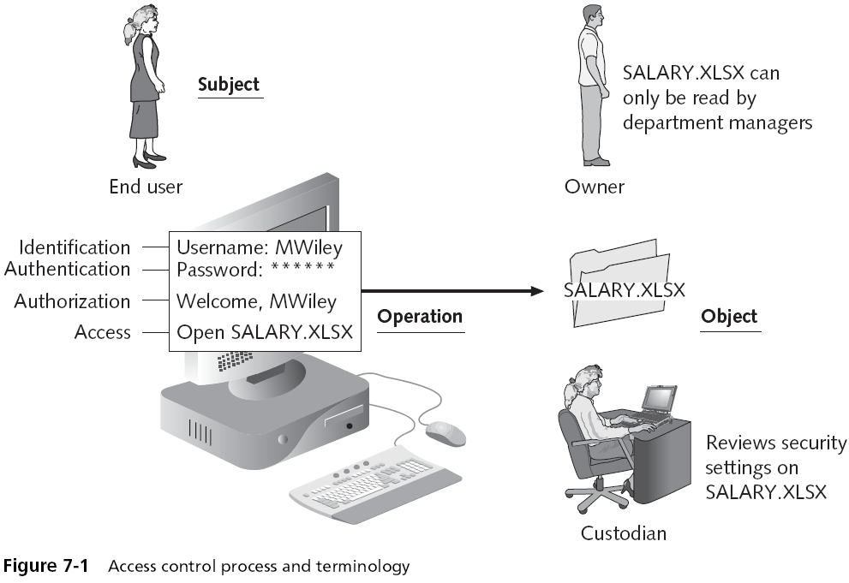

Slide 11
Access Control Models
Mandatory Access Control
Discretionary Access Control
Role-Based Access Control
Rule-Based Access Control

Slide 12
Mandatory Access Control (MAC) model
Most restrictive model—used by the military
Objects and subjects are assigned access levels
Unclassified, Classified, Secret, Top Secret
The end user cannot implement, modify, or transfer any controls

Slide 13
Discretionary Access Control (DAC) model
The least restrictive--used by Windows computers in small networks
A subject has total control over any objects that he or she owns
Along with the programs that are associated with those objects
In the DAC model, a subject can also change the permissions for other subjects over objects

Slide 14
DAC Has Two Significant Weaknesses
  It relies on the end-user subject to set the proper level of security
  A subject’s permissions will be “inherited” by any programs that the subject executes

Slide 15
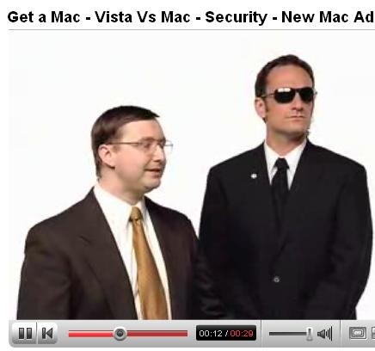
User Account Control
Cruel Mac Video
Link Ch 7c

Slide 16
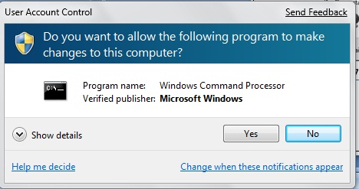
User Account Control (UAC)
  Asks the user for
  permission when
  installing
  software
Principle of least privilege
  Users run with limited privileges by default
  Applications run in standard user accounts
  Standard users can perform common tasks

Slide 17
Role Based Access Control (RBAC) model
Sometimes called Non-Discretionary Access Control
Used in Windows corporate domains
Considered a more “real world” approach than the other models
Assigns permissions to particular roles in the organization, such as “Manager” and then assigns users to that role
Objects are set to be a certain type, to which subjects with that particular role have access

Slide 18
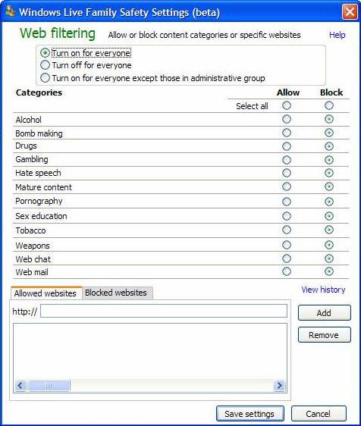
Rule Based Access Control (RBAC) model
Also called the Rule-Based Role-Based Access Control (RB-RBAC) model or automated provisioning
Controls access with rules defined by a custodian
  Example: Windows Live Family Safety

Slide 19
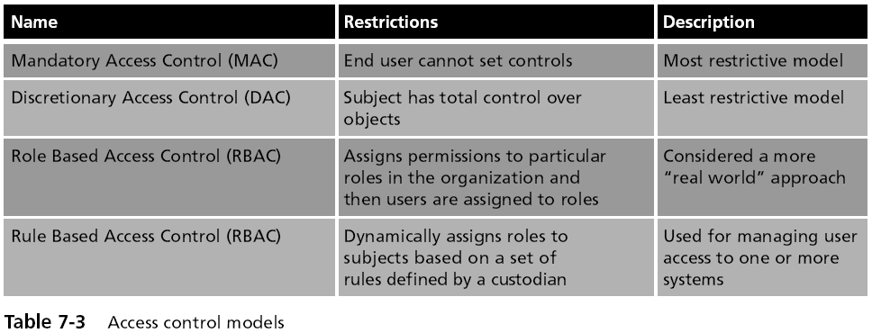
Access Control Models (continued)

Slide 20
Best Practices for Access Control
Separation of duties
  No one person should control money or other essential resources alone
    Network administrators often have too much power and responsibility
Job rotation
  Individuals are periodically moved from one job responsibility to another

Slide 21
Best Practices for Access Control
Least privilege
  Each user should be given only the minimal amount of privileges necessary to perform his or her job function
Implicit deny
  If a condition is not explicitly met, access is denied
  For example, Web filters typically block unrated sites

Slide 22
Logical Access Control Methods

Slide 23
Access Control Methods
The methods to implement access control are divided into two broad categories
  Physical access control and
  Logical access control
Logical access control includes
  Access control lists (ACLs)
  Group policies
  Account restrictions
  Passwords

Slide 24
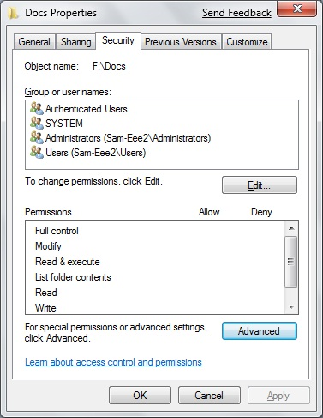
Access Control
List (ACL)
A set of permissions
attached to an object
Specifies which subjects
are allowed to access the
object
And what operations they
can perform on it
Every file and folder has an ACL
Access control entry (ACE)
  Each entry in the ACL table in the Microsoft Windows, Linux, and Mac OS X operating systems

Slide 25
Windows Access Control Entries (ACEs)
In Windows, the ACE includes
  Security identifier (SID) for the user or group
  Access mask that specifies the access rights controlled by the ACE
  A flag that indicates the type of ACE
  A set of flags that determine whether objects can inherit permissions

Slide 26
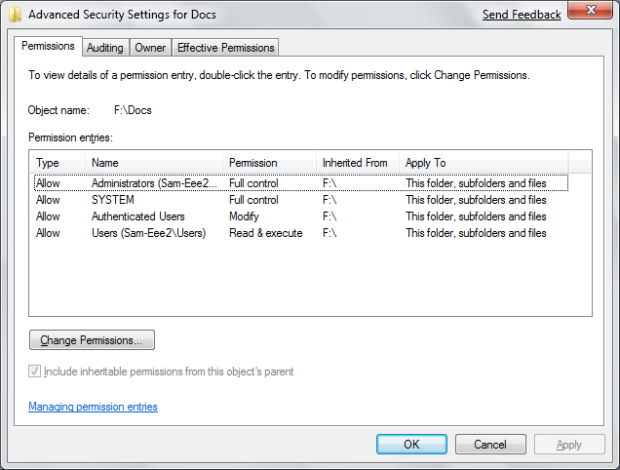
Advanced Security Settings in Windows 7 Beta

Slide 27
Group Policy
A Microsoft Windows feature that provides centralized management and configuration of computers and remote users
Using the Microsoft directory services known as Active Directory (AD)
Group Policy is used in corporate domains to restrict user actions that may pose a security risk
Group Policy settings are stored in Group Policy Objects (GPOs)

Slide 28
Account Restrictions
Time of day restrictions
  Limit when a user can log on to a system
  These restrictions can be set through a Group Policy
  Can also be set on individual systems
Account expiration
  The process of setting a user’s account to expire
  Orphaned accounts are user accounts that remain active after an employee has left an organization
    Can be controlled using account expiration

Slide 29
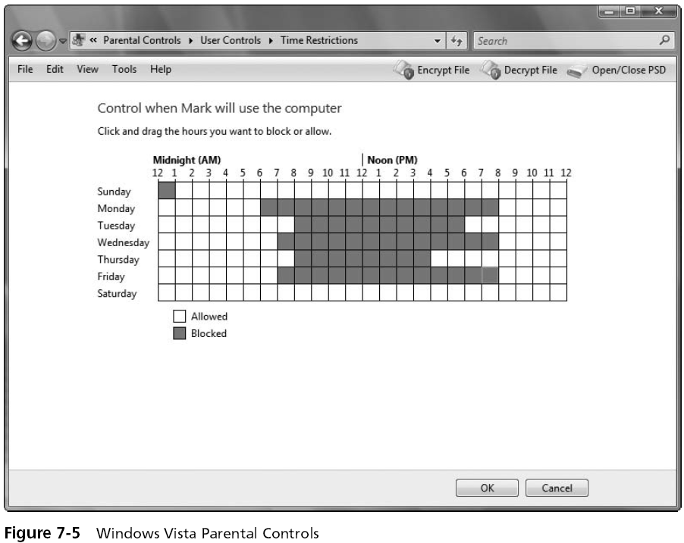

Slide 30
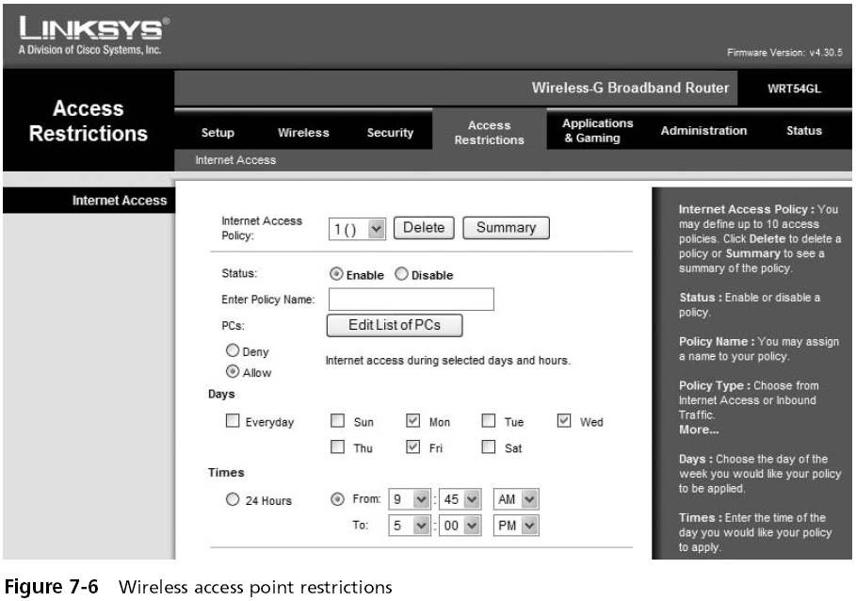

Slide 31
Passwords
The most common logical access control
Sometimes referred to as a logical token
A secret combination of letters and numbers that only the user knows
A password should never be written down
  Must also be of a sufficient length and complexity so that an attacker cannot easily guess it (password paradox)

Slide 32
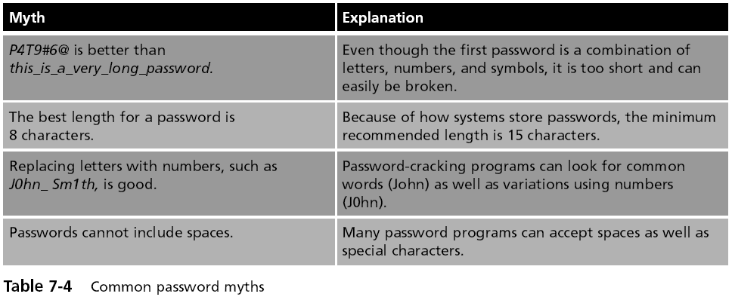
Passwords Myths

Slide 33
Attacks on Passwords
Brute force attack
  Simply trying to guess a password through combining a random combination of characters
Passwords typically are stored in an encrypted form called a “hash”
  Attackers try to steal the file of hashed passwords and then break the hashed passwords offline

Slide 34
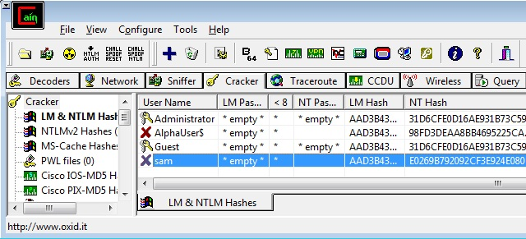
How to Get the Hashes
Easy way: Just use Cain
Cracker tab, right-click, "Add to List"

Slide 35
Attacks on Passwords
Dictionary attack
  Guess passwords from a dictionary
  Works if the password is a known common password
Rainbow tables
  Make password attacks faster by creating a large pregenerated data set of hashes from nearly every possible password combination
  Works well against Windows passwords because Microsoft doesn't use the salting technique when computing hashes

Slide 36
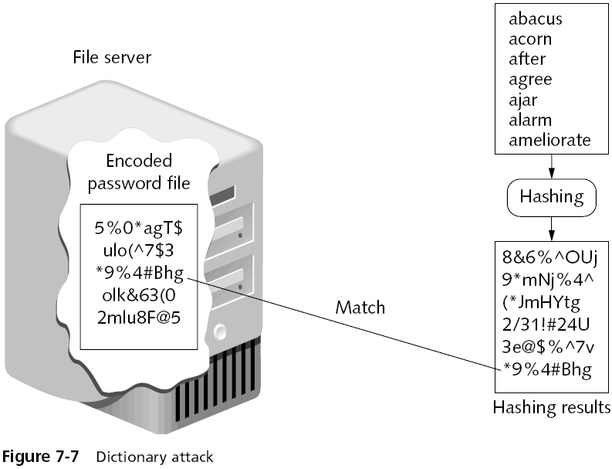

Slide 37
Rainbow Tables
Generating a rainbow table requires a significant amount of time
Rainbow table advantages
  Can be used repeatedly for attacks on other passwords
  Rainbow tables are much faster than dictionary attacks
  The amount of time needed on the attacking machine is greatly reduced

Slide 38
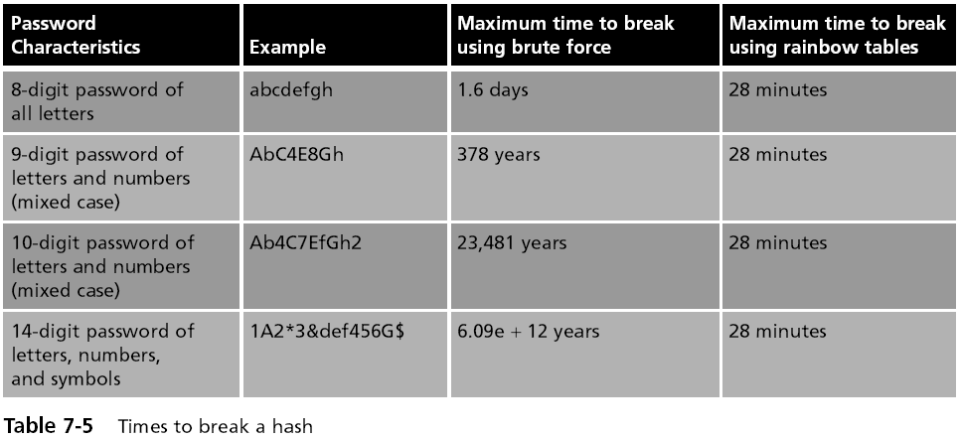
Rainbow Table Attack

Slide 39
Passwords (continued)
One reason for the success of rainbow tables is how older Microsoft Windows operating systems hash passwords
A defense against breaking encrypted passwords with rainbow tables
  Hashing algorithm should include a random sequence of bits as input along with the user-created password
These random bits are known as a salt
  Make brute force, dictionary, and rainbow table attacks much more difficult

Slide 40
No Salt!
To make hashing stronger, add a random "Salt" to a password before hashing it
Windows doesn't salt its hash!
Two accounts with the same password hash to the same result, even in Windows 7 Beta!
This makes it possible to speed up password cracking with precomputed Rainbow Tables

Slide 41

Demonstration
Here are two accounts on a Windows 7 Beta machine with the password 'password'
This hash is from a different Windows 7 Beta machine

Slide 42

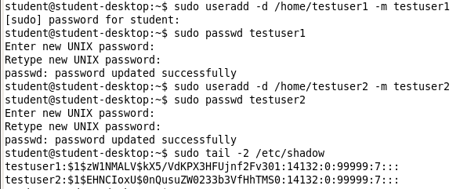
Linux Salts its Hashes

Slide 43
Password Policy
A strong password policy can provide several defenses against password attacks
The first password policy is to create and use strong passwords
One of the best defenses against rainbow tables is to prevent the attacker from capturing the password hashes
A final defense is to use another program to help keep track of passwords

Slide 44
Domain Password Policy
Setting password restrictions for a Windows domain can be accomplished through the Windows Domain password policy
There are six common domain password policy settings, called password setting objects
  Used to build a domain password policy

Slide 45
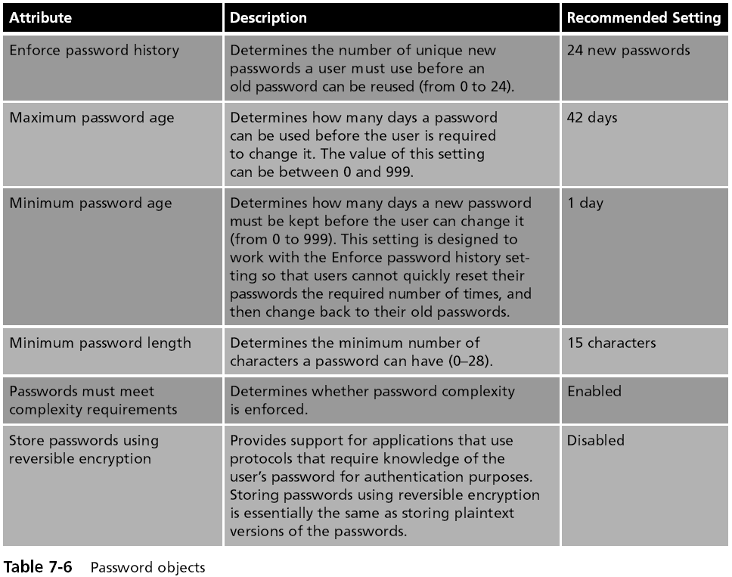

Slide 46
Physical Access Control

Slide 47
Physical Access Control
Physical access control primarily protects computer equipment
  Designed to prevent unauthorized users from gaining physical access to equipment in order to use, steal, or vandalize it
Physical access control includes computer security, door security, mantraps, video surveillance, and physical access logs

Slide 48
Physical Computer Security
Physically securing network servers in an organization is essential
Rack-mounted servers
  4.45 centimeters (1.75 inches) tall
  Can be stacked with up to 50 other servers in a closely confined area
KVM (Keyboard, Video, Mouse) Switch
  Needed to connect to the servers
  Can be password-protected

Slide 49
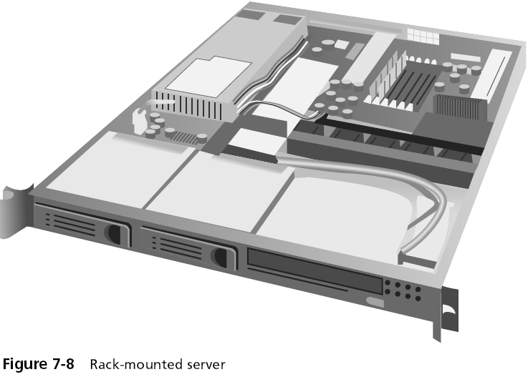

Slide 50
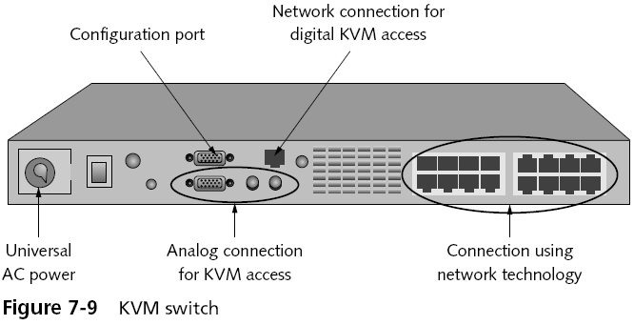
KVM Switch

Slide 51
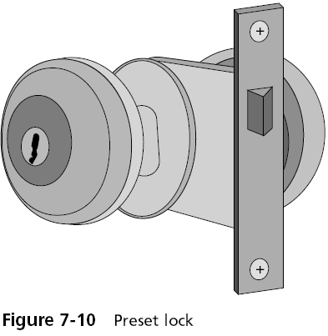
Door Security
Hardware locks
  Preset lock
    Also known as the key-in-knob lock
    The easiest to use because it requires only a key for unlocking the door from the outside
    Automatically locks behind the person, unless it has been set to remain unlocked
    Security provided by a preset lock is minimal

Slide 52
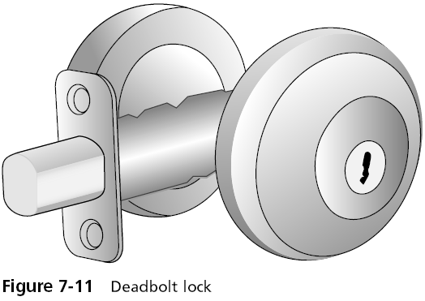
Deadbolt lock
Extends a solid metal bar into the door frame
Much more difficult to defeat than preset locks
Requires that the key be used to both open and lock the door

Slide 53
Lock Best Practices
Change locks immediately upon loss or theft of keys
Inspect all locks on a regular basis
Issue keys only to authorized persons
Keep records of who uses and turns in keys
Keep track of keys issued, with their number and identification
Master keys should not have any marks identifying them as masters

Slide 54
Lock Best Practices
Secure unused keys in a locked safe
Set up a procedure to monitor the use of all locks and keys and update the procedure as necessary
When making duplicates of master keys, mark them “Do Not Duplicate,” and wipe out the manufacturer’s serial numbers to keep duplicates from being ordered

Slide 55
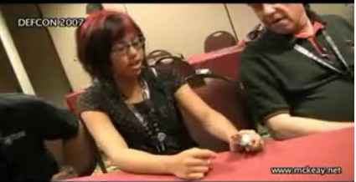
Lockpicking at DEFCON
See links Ch 7e, 7f

Slide 56
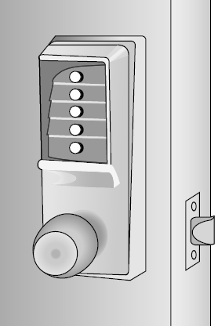
Cipher Lock
Combination locks that use buttons that must be pushed in the proper sequence to open the door
Can be programmed to allow only the code of certain individuals to be valid on specific dates and times
Cipher locks also keep a record of when the door was opened and by which code
Cipher locks are typically connected to a networked computer system
  Can be monitored and controlled from one central location

Slide 57
Cipher Lock Disadvantages
Basic models can cost several hundred dollars while advanced models can be even more expensive
Users must be careful to conceal which buttons they push to avoid someone seeing or photographing the combination

Slide 58
Tailgate Sensor
Uses infrared beams that are aimed across a doorway
Can detect if a second person walks through the beam array immediately behind (“tailgates”) the first person
  Without presenting credentials

Slide 59
Physical Tokens
Objects to identify users
ID Badge
  The most common types of physical tokens
  ID badges originally were visually screened by security guards
  Today, ID badges can be fitted with tiny radio frequency identification (RFID) tags
    Can be read by an RFID transceiver as the user walks through the door with the badge in her pocket

Slide 60
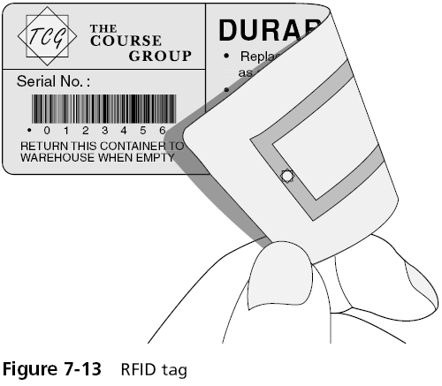
Door Security (continued)

Slide 61
Mantrap
Before entering a secure area, a person must enter the mantrap
  A small room like an elevator
If their ID is not valid, they are trapped there until the police arrive
Mantraps are used at high-security areas where only authorized persons are allowed to enter
  Such as sensitive data processing areas, cash handling areas, critical research labs, security control rooms, and automated airline passenger entry portals

Slide 62
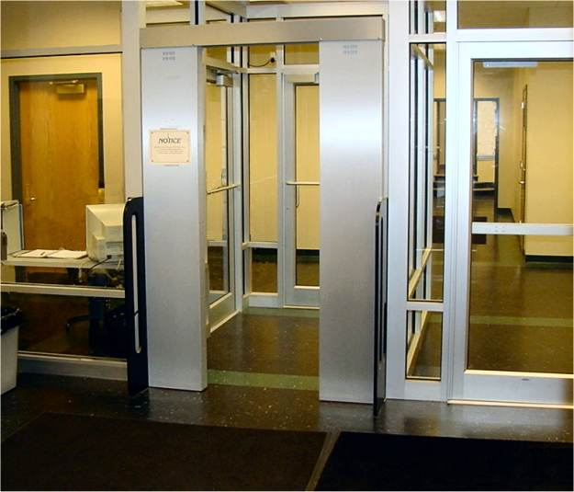
Mantrap

Slide 63
Video Surveillance
Closed circuit television (CCTV)
  Using video cameras to transmit a signal to a specific and limited set of receivers
Some CCTV cameras are fixed in a single position pointed at a door or a hallway
Other cameras resemble a small dome and allow the security technician to move the camera 360 degrees for a full panoramic view

Slide 64
Physical Access Log
  A record or list of individuals who entered a secure area, the time that they entered, and the time they left the area
  Can also identify if unauthorized personnel have accessed a secure area
Physical access logs originally were paper documents
  Today, door access systems and physical tokens can generate electronic log documents

